Slide 1
Data Science Bootcamp
Midterm Project
Presented by Michael Boddy & Siu Kei Cheung @18 Mar 2022

Slide 2
Rent a house in New York City

Slide 3
Neighborhood Segmentation
Rent Prices
No of Schools
Crime Rate
Features
No of Hospitals
Population
No of Bus Stations

Slide 4
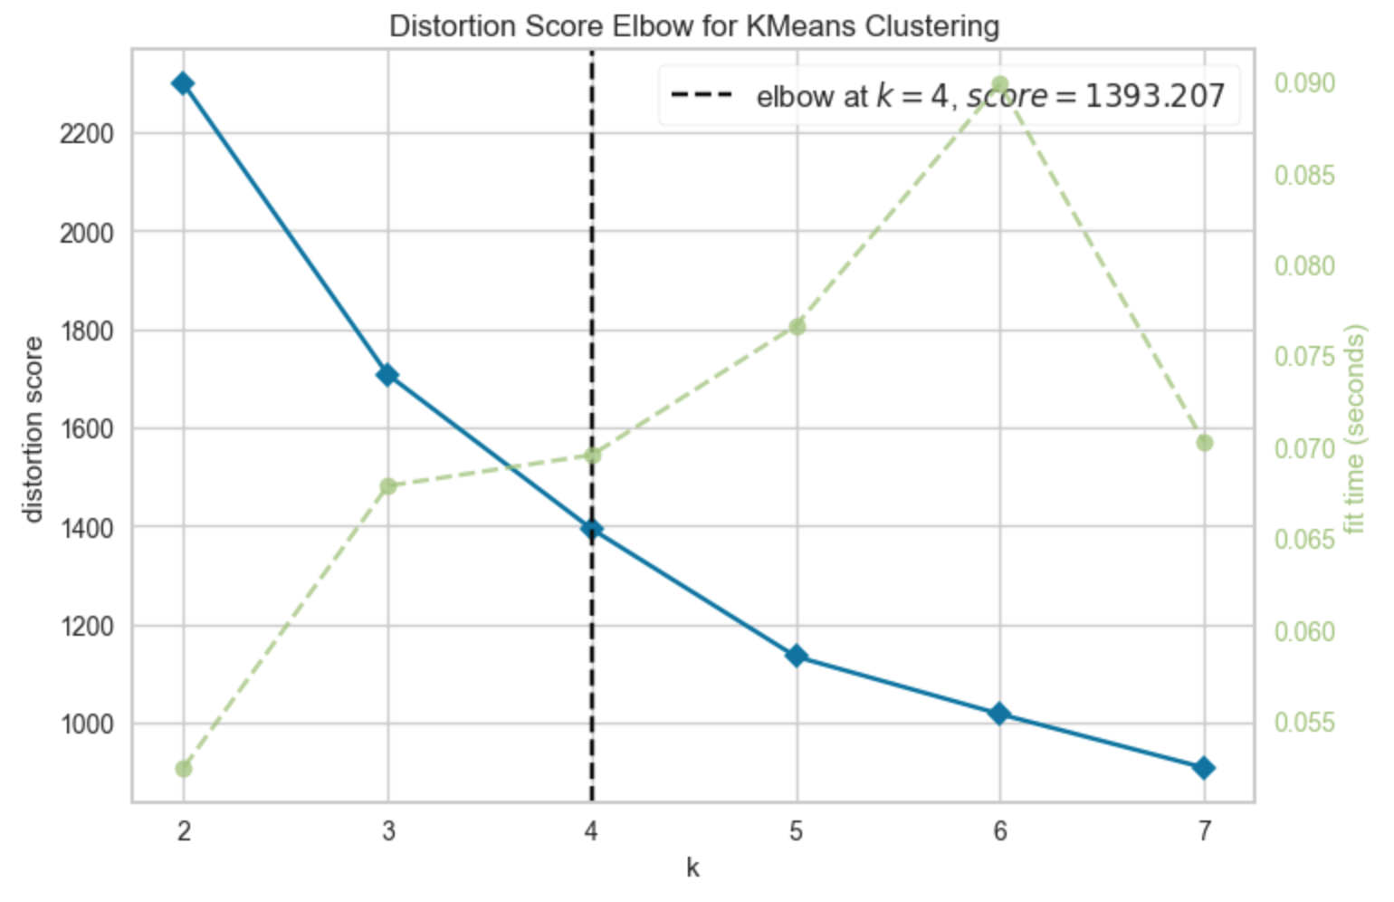
Neighborhood Segmentation
Kmeans
Income
Age
Years with Bank No of Children

Slide 5
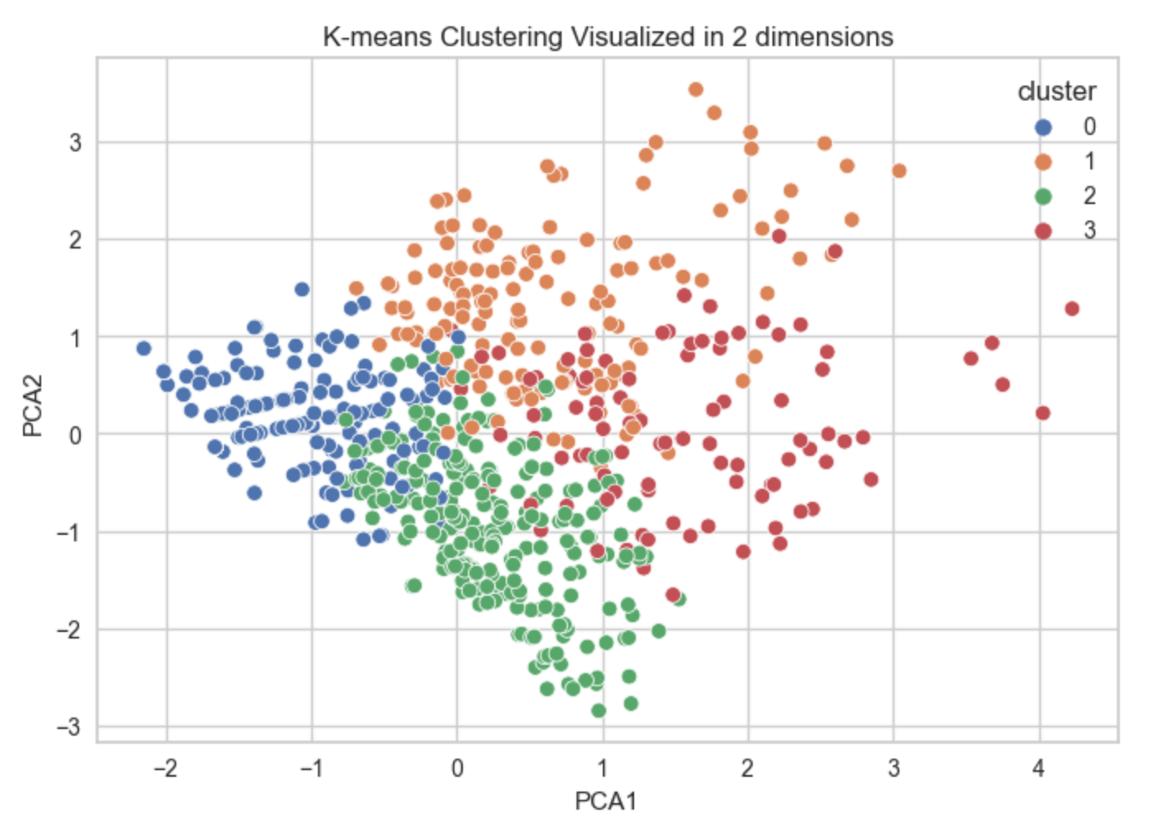
Customer Segmentation T01
Kmeans
Income
Age
Years with Bank No of Children

Slide 6
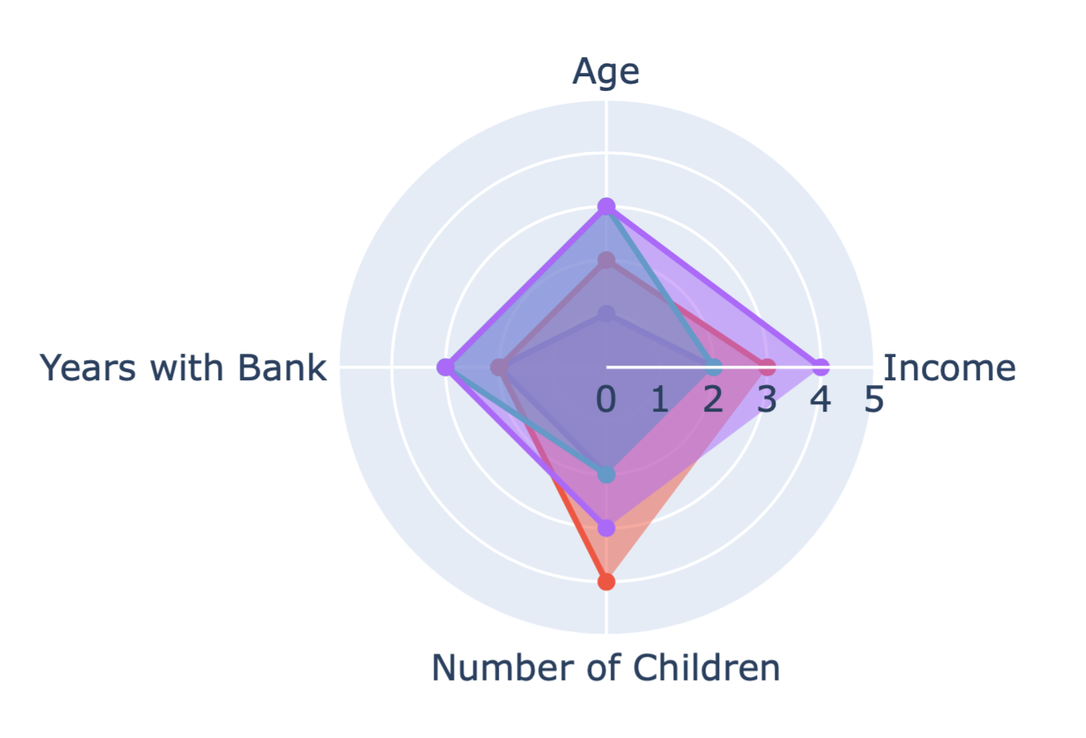
Customer Segmentation T01
Kmeans
Income
Age
Years with Bank No of Children

Slide 7
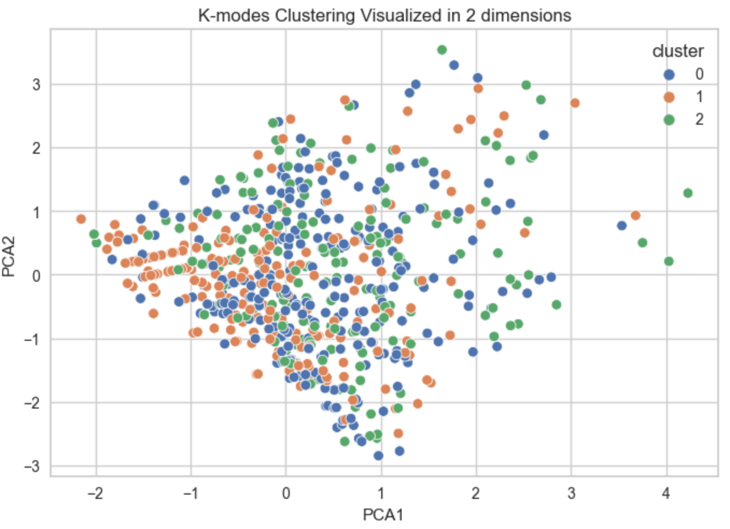
Customer Segmentation T01
Kmodes
Gender
Marital Status City
State

Slide 8
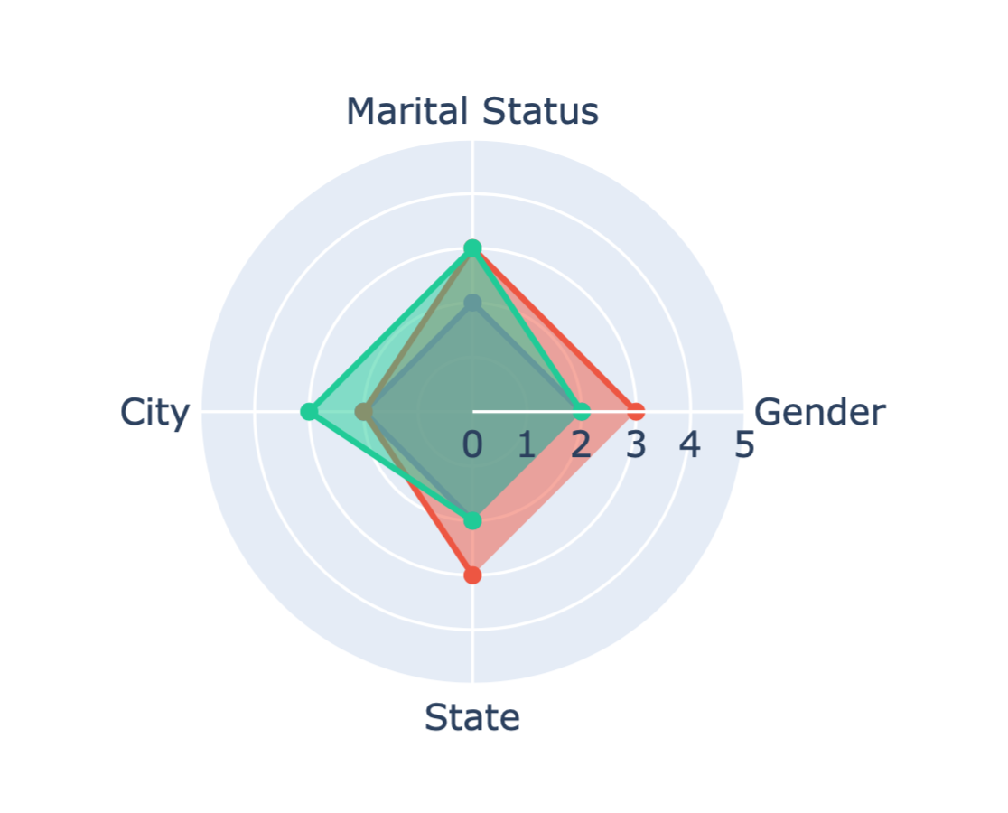
Customer Segmentation T01
Kmodes
Gender
Marital Status City
State

Slide 9
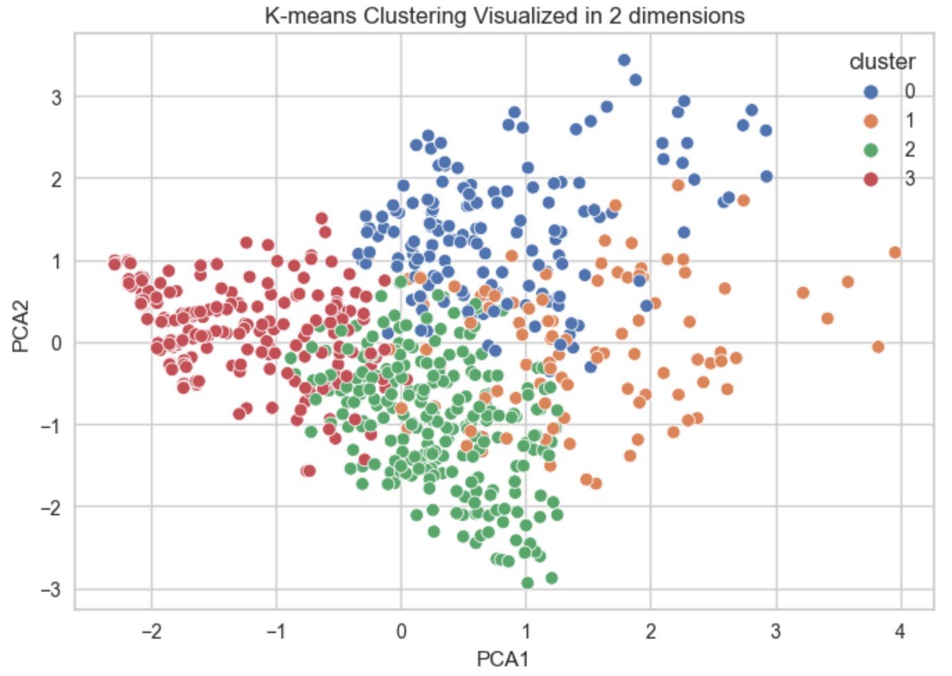
Customer Segmentation T01
Kmeans
Income
Age
Years with Bank No of Children
Gender
Marital Status City
State

Slide 10
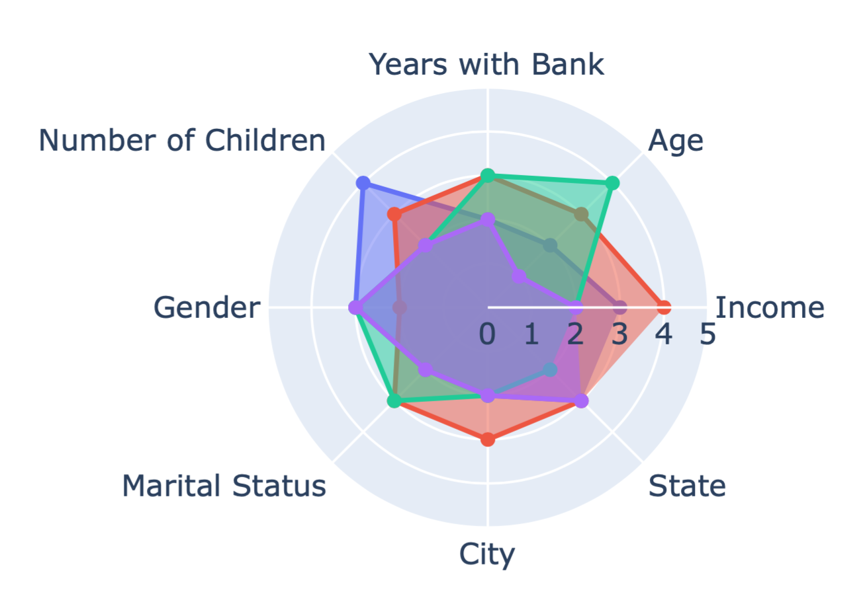
Customer Segmentation T01
Kmeans
Income
Age
Years with Bank No of Children
Gender
Marital Status City
State

Slide 11
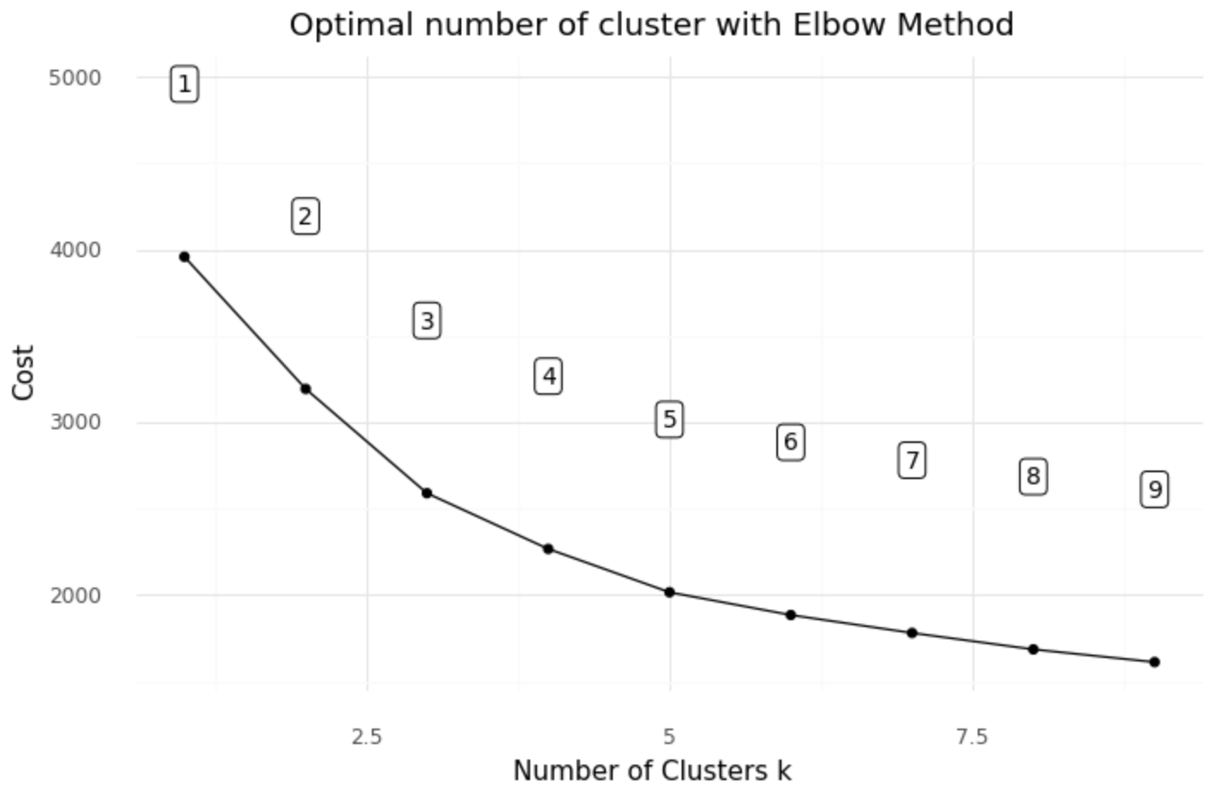
Customer Segmentation T01
KPrototype
Income
Age
Years with Bank No of Children
Gender
Marital Status City
State

Slide 12
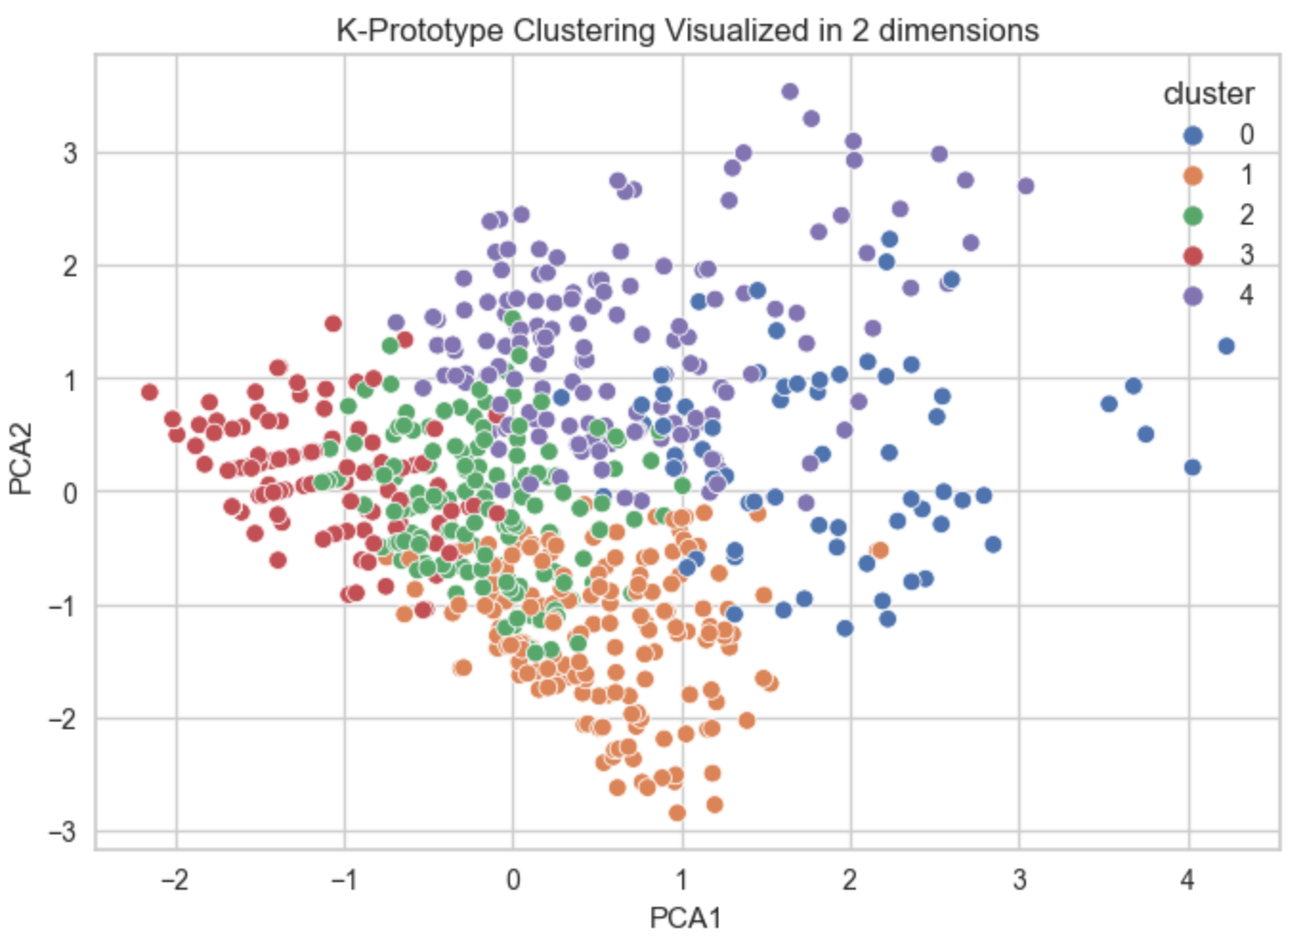
Customer Segmentation T01
KPrototype
Income
Age
Years with Bank No of Children
Gender
Marital Status City
State

Slide 13
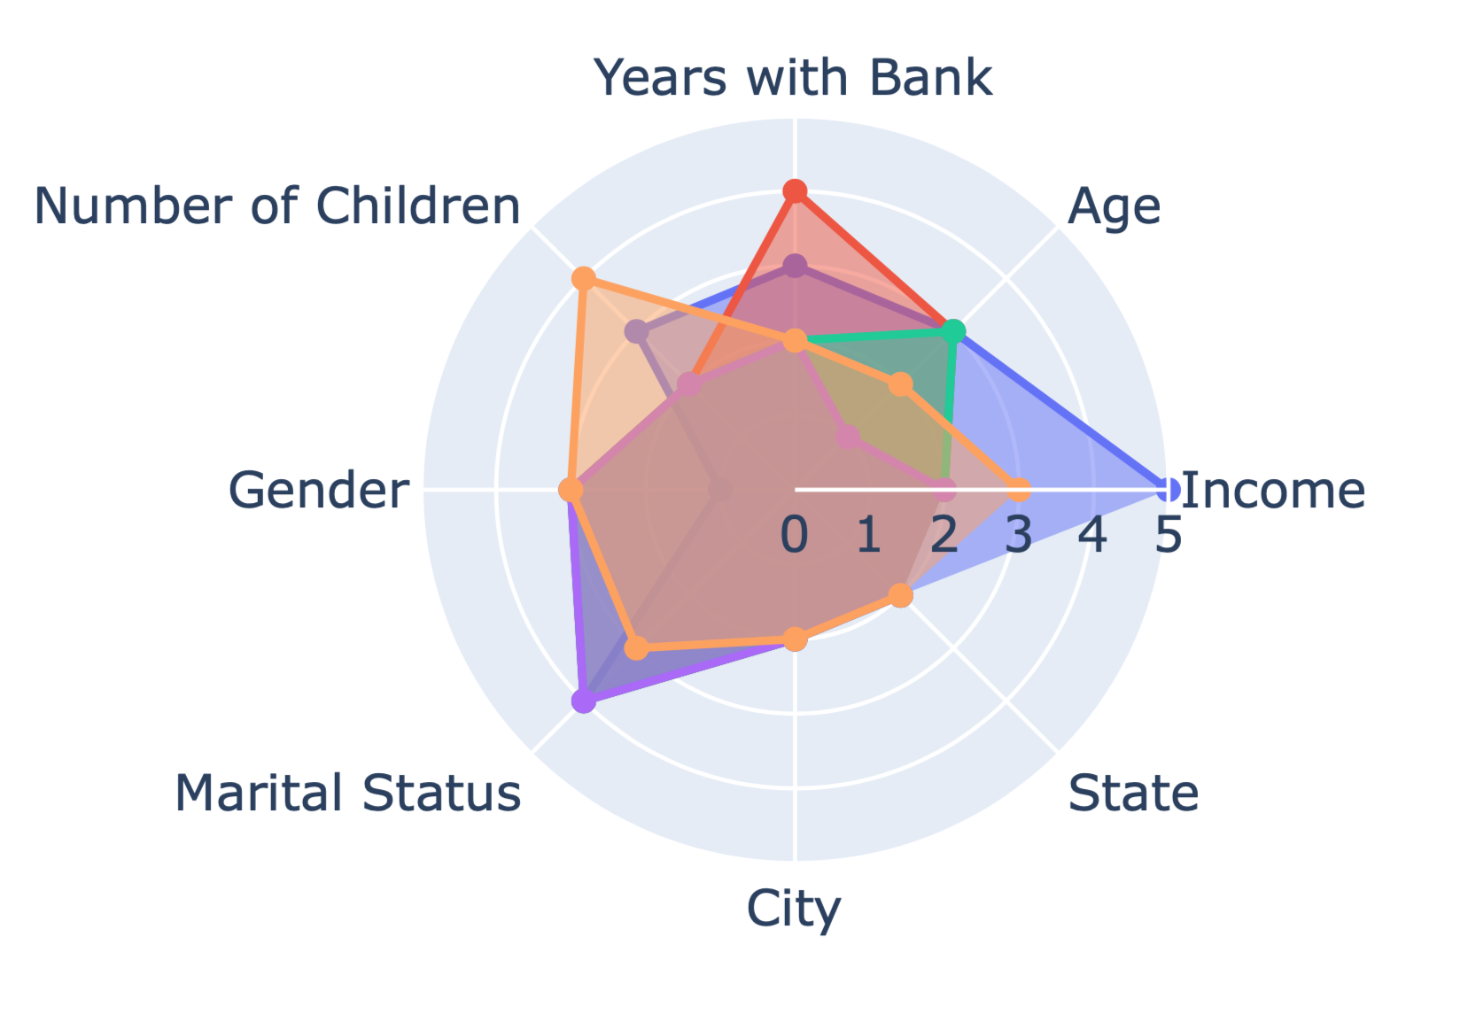
Customer Segmentation T01
KPrototype
Income
Age
Years with Bank No of Children
Gender
Marital Status City
State

Slide 14
Customer Segmentation T02
Features
Categorical
Continuous
Age
Net Ending Balance (sv + ck - cc)
Gender
Net Difference(net end – net start)
Marital Status
Total Number of Transactions
Banking
Behavior
Total Spending (negative transactions)
City
Profile
Percentage of Saving Account Spending
No. of Children
Percentage of Chequing Account Spending
Years with Bank
Percentage of Credit Card Spending
Income
Credit Limit

Slide 15
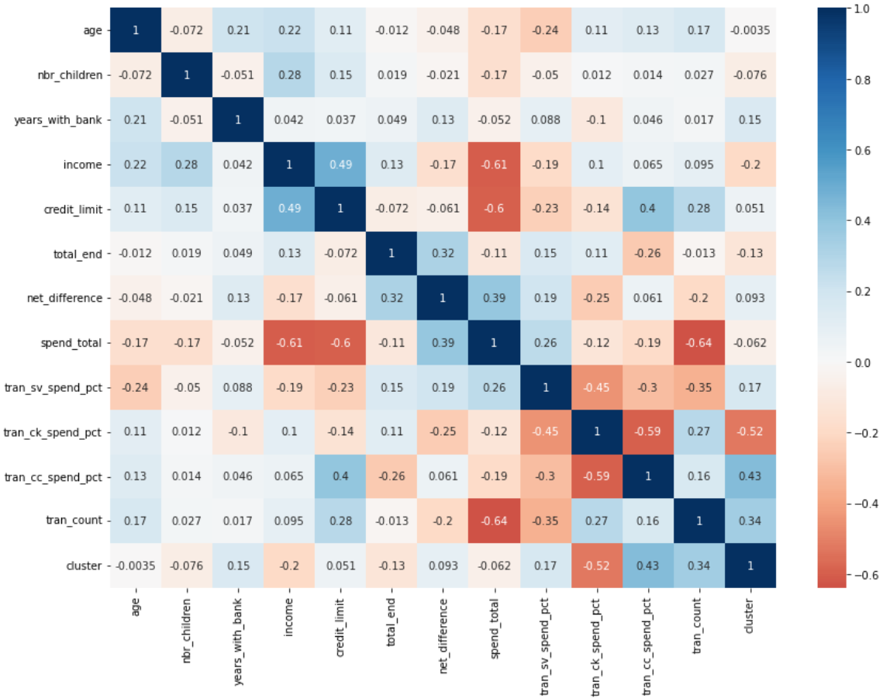
Customer Segmentation T02
Features Correlations

Slide 16
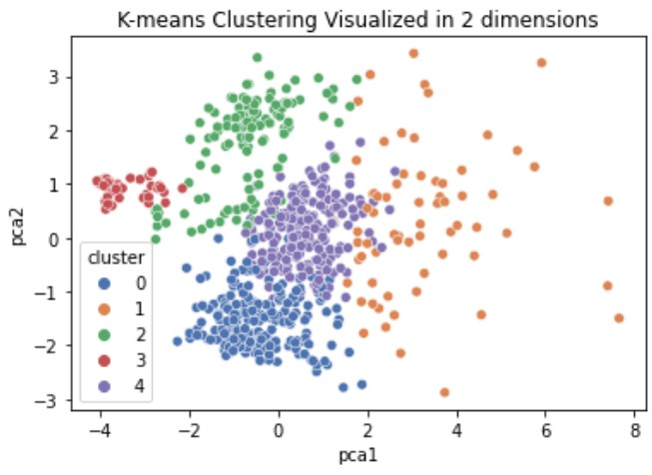
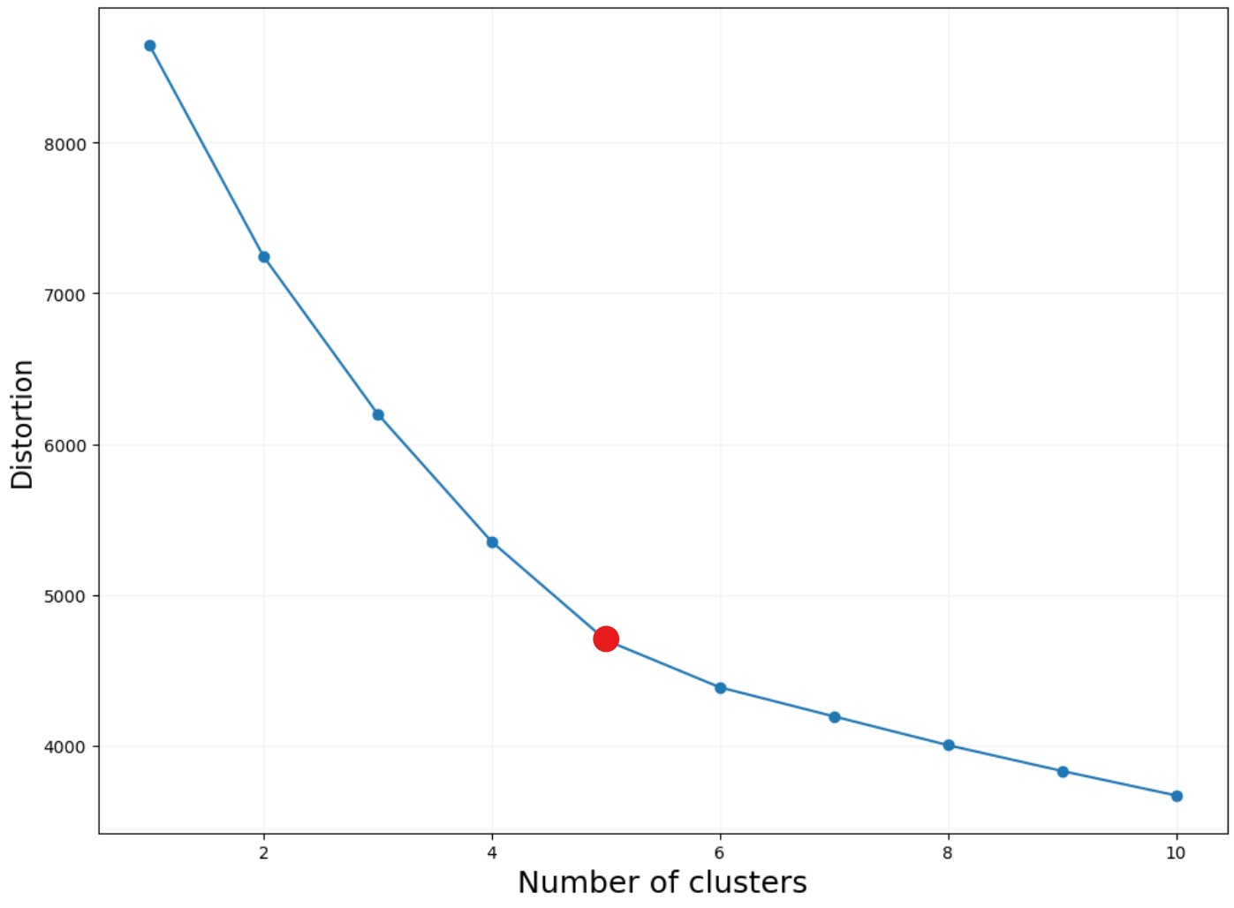
Customer Segmentation T02
Clustering result
KMeans
Continuous Features
(12)
num_of_clusters = 5

Slide 17
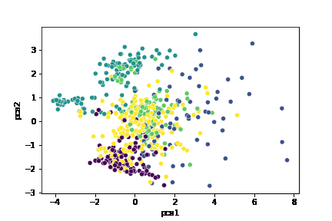
Customer Segmentation T02
Stretch Task: K-means Clustering Process
(num_of_iteration = 20)
KMeans
Continuous Features
(12)

Slide 18
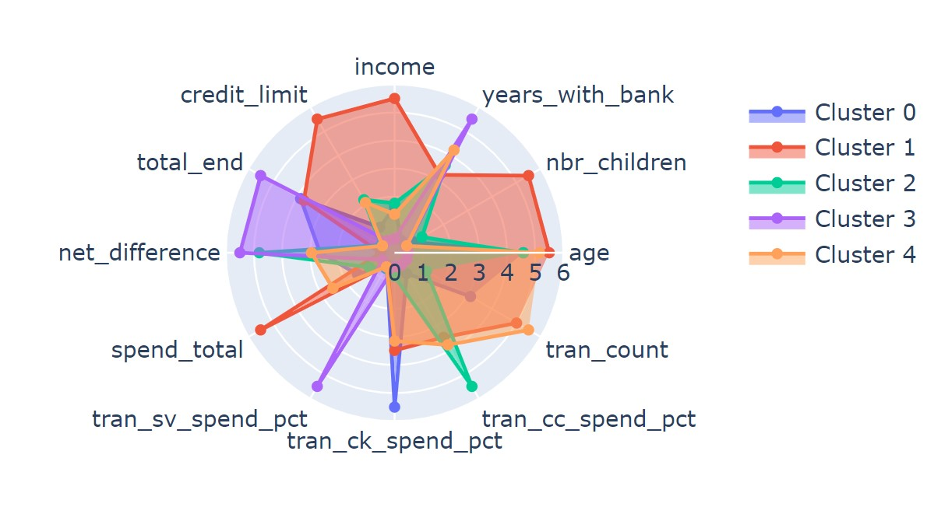
Customer Segmentation T02
Clustering result
KMeans
Continuous Features
(12)

Slide 19
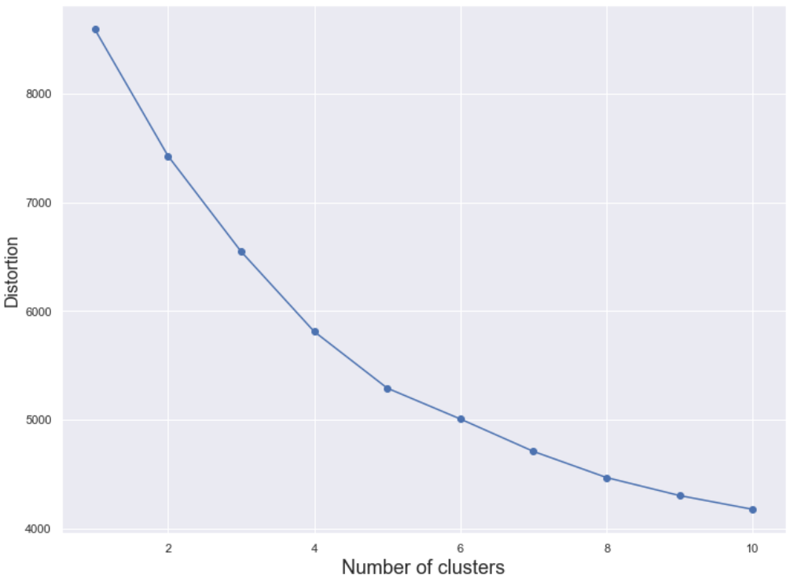
Customer Segmentation T02
Clustering result
KPrototypes
Continuous
Features
Continuous
&
Categorical
Features
vs
num_of_clusters = 5
Clustering Results Comparison :
Difference is 2 out of 665.
Continuous Features (12)
+
Categorical
Features (3)

Slide 20
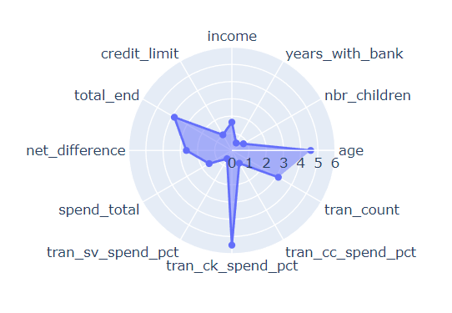
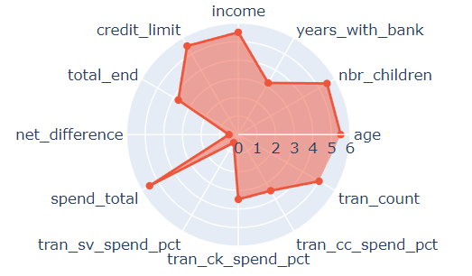
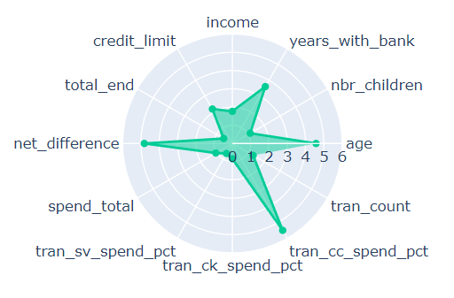
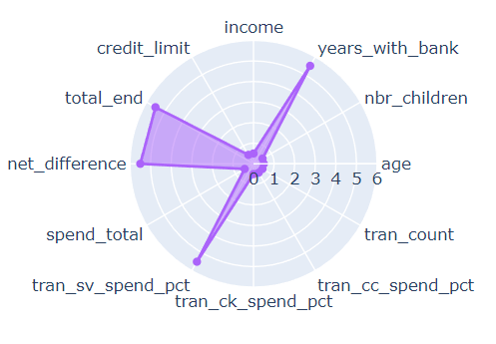
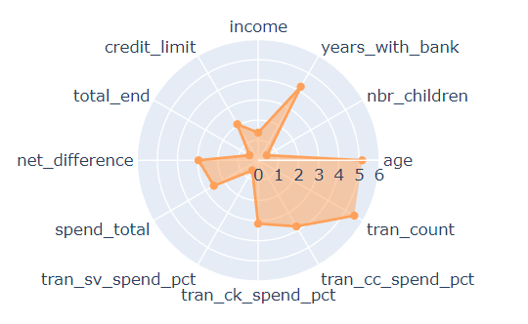
Customer Segmentation T02
Analysis and Solutions
Cluster 0: Mid age, almost only use chequing, low income,
spend less, least loyal
(new customer, Gift, Promotions)
Cluster 1: Mid age/elders, high income, more kids, more
savings, high credit limit, spend most, more engaged,
barely use saving account to pay
(Recommend Family/health Insurance, Investments)
Cluster 2: Mid age, mid income, less kids, use credit card
most, spend less, more debt, been saving
money (Hardworking and thrifty, Saving promotions)
Cluster 3: Young, least engaged, most savings, use saving
account for transactions, most loyal (emergency
fund/student, Recommend Small Investments)
Cluster 4: Mid age/Elders, low/mid income no/less kids, more loyal,
more engaged, no savings, more debt (Retired, Gifts)

Slide 21
Biggest Challenges
Feature Engineering
Categorical Features
(Clustering Methods: K-mean, K-modes, K-prototype)
(Encoding Methods: One Hot Encoding, Label Encoding, Frequency Encoding)
Evaluation of the clustering result

Slide 22
THANK YOU FOR YOUR ATTENTION!
Daisy Sui & Siu Kei Cheung

